Slide 1

Social Media Analysis
- Kvss Bharadwaj
- 18 / 05 / 2026

Slide 2
About the Project
🗄️ Databases . .
INTRODUCTION
Instagram style relational databases - - users, photos, likes, comments, follows, tags, photo_tags tables.
What is this project?
📌
Analyzing a social media platform's database to uncover user behaviour & engagement patterns.
🛠️ Language & Topics . .
📊
Answer 13 objective + 10 subjective business questions using SQL queries.
MySQL - - Queries, CTEs, Window Functions, Joins, Aggregations, Subqueries.
🎯
Deriving insights on top users, influencers, hashtags, and campaign strategy.

Slide 3
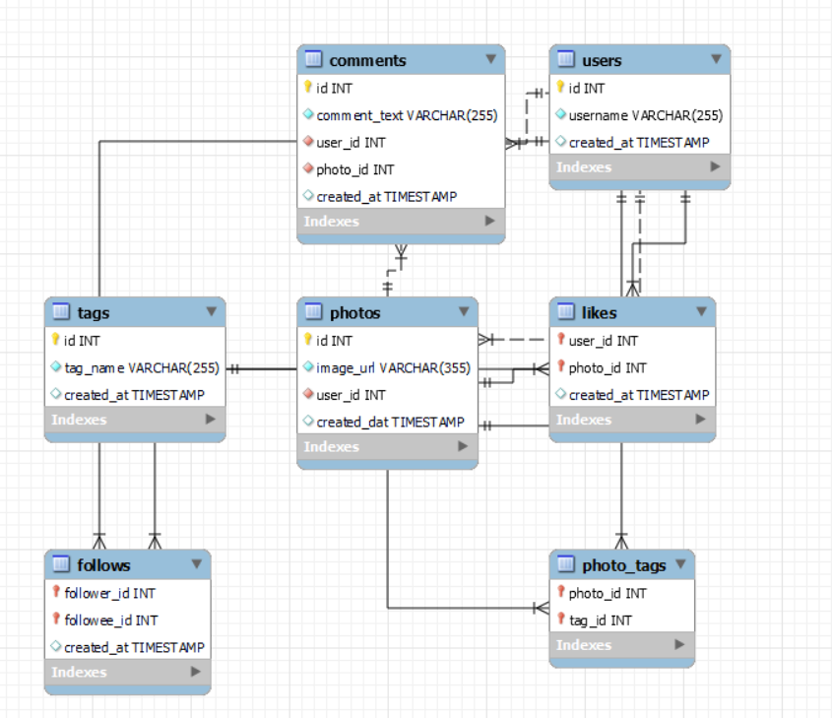

Slide 4
Objectives &
Problem Statement
❓ Problem Statement: How can we analyse user activity, engagement, and content data from a social media platform to derive actionable business insights?
📈
Analyse Activity
🏷️
Tag Analytics
Measuring distribution of posts, likes & comments across all users
Calculate average number of tags per post using photo_tags table
🏆
Rank Engagement
👥
Followers & Following
Identify & rank top users by total engagement (likes + comments)
Find users with highest follower and following counts
#️⃣
Hashtag Insights
🎯
Campaign Strategy
Retrieve hashtags with highest average likes per post
Segment users for targeted marketing & influencer campaigns

Slide 5
Social Media
Data Snapshot
100
257
8,782
7
Users
Photos
Likes
Tables
in the platform database
total posts across all users
total like interactions
users · photos · likes · comments
follows · tags · photo_tags
KEY DATA POINTS
🧹 Data Quality
💡 Why It Matters
👥
100
registered users
No duplicate records found
Reveals real user behaviour patterns
📸
257
photos posted
No NULL values present
Enables influencer identification
❤️
8,782
total likes recorded
All user IDs consistent
Powers campaign targeting
💬
7,488
comments made
🔁
7,623
follow relationships
Referential integrity maintained
Guides content strategy

Slide 6
Analytical Approach &
Methodology
01
🔍
Data
Exploration
02
🧹
Data
Quality Check
03
🔗
Table
Joins
Examined all 7 tables — users, photos, likes, comments, follows, tags, photo_tags
Verified zero NULLs & duplicates across every table
Used LEFT JOINs + COALESCE to include users with zero activity
›
›
04
📊
CTEs &
Aggregation
05
🏅
Ranking &
Windows
06
💡
Business
Insights
Built multi-step CTEs to calculate likes, comments, and engagement scores
Applied RANK() OVER() window functions to rank users and influencers
Translated SQL results into strategy: influencers, hashtags, UGC campaigns
›
›

Slide 7
Objective Question 2
User Activity Distribution
KEY FINDINGS
📌
26 users (26%) have never posted — a major inactive segment.
📈
Most active users post 1–5 photos; very few post more than 6
❤️
Top user gave 94 likes; 23 users gave zero likes at all
💬
One power user made 257 comments — 13× the average
🎯
Re-engagement campaigns needed for the 26 non-posting users

Slide 8
Objective Questions 4 & 6
Top User Engagement Ranking
🥇 #1
Score: 749
Eveline95
Avg/post: 62.42
🥈 #2
Score: 646
Cesar93
Avg/post: 64.60
🥉 #3
Score: 392
Donald.Fritsch
Avg/post: 65.33
💡 Insight
Avg engagement/post matters more than total score - - Donald.Fritsch leads at 65.33 per post.

Slide 9
Objective Question 5
Followers
TAKEAWAYS
👑
Top influencers all share 77 followers — highly competitive tier
🔁
Mutual follow users identified via self-join query

Slide 10
Objective Questions 3 & 12
Tags, Hashtags
Avg Tags / Post: 1.95
TAKEAWAYS
🏷️
Average 1.95 tags per post across 257 photos
1.95
#️⃣
#delicious leads with 65.27 engagement rate on 15 posts
avg tags
per post
📣
Food & lifestyle hashtags drive the most interaction
#delicious
Top hashtag · 65.27 engagement rate · 15 photos

Slide 11
Subjective Questions 1 & 6
Loyal Users & Segmentation
🏆 Most Loyal Users (by Total Engagement)
👥 User Segments for Targeted Campaigns
🥇
Eveline95
ID: 23
⭐
Power Users
📣
Influencer Tier
Score: 749 · VIP early access + exclusive badge
High posts + high engagement
→ VIP rewards, early access, badges
77 followers + strong avg/post
→ Sponsored posts, ambassador deals
🥈
Clint27
ID: 88
Score: 612 · Personalized discounts + rewards
💬
Casual Users
🔔
Inactive Users
Some activity, lower engagement
→ Content recommendations, nudges
0 posts or 0 likes detected
→ Re-engagement emails + incentives
🥉
Donald.Fritsch
ID: 77
Score: 392 · Referral rewards + recognition

Slide 12
Subjective Questions 3 & 5
Hashtag Strategy & Influencer Marketing
🌟 Influencer Outreach Approach
01
Identify
Rank by followers (77) + avg engagement/post. Top: Donald.Fritsch (65.33), Aurelie71 (65.25), Cesar93 (64.60)
02
Engage
Start engaging naturally with their content — like, comment, share before reaching out
03
Approach
Send a short personalised DM explaining why they are a good brand fit for the campaign
📊 Content Strategy
04
Collaborate
Target food/lifestyle hashtags in ad campaigns. Use #delicious (65.27 rate) as anchor hashtag for highest organic reach.
Propose: sponsored post, giveaway, product review, or long-term ambassador partnership

Slide 13
Based on SQL Analysis Findings
Strategic Recommendations
🔁
📣
#️⃣
Re-engage
Inactive Users
Launch
Influencer Campaign
Hashtag-led
Ad Strategy
26 users have 0 posts
Target top 7 users (77 followers)
Anchor on #delicious (65.27 rate)
Personalised push notifications
Avg eng/post > 62 threshold
Build campaigns on food themes
Easy-return incentive offer
Sponsored post + giveaway model
Repurpose high-UGC posts as ads
Goal: move them to 1st post
Measure via CTR & conversion rate
A/B test creatives per hashtag

Slide 14
CONCLUSION
Key Findings & Conclusion
MAIN INSIGHTS RECAP
RECOMMENDATIONS
01
📊
26% of users are completely inactive — re-engagement is the #1 priority for growth.
🎯
Segment users by engagement tier for personalised campaigns
📈
Shift ad spend to high-engagement hashtag themes
02
🏆
Eveline95 & Clint27 are the most loyal users — they deserve VIP rewards and recognition
🤝
Launch influencer programme with top 7 identified users
03
📣
Top 7 users (77 followers each) are ideal influencer candidates for brand campaigns
🔁
Deploy re-engagement flows for 26 zero-post users
04
#️⃣
#delicious (65.27 eng. rate) should anchor all food & lifestyle advertising campaigns
05
💡
Avg engagement per post is more meaningful than total score when selecting influencers

Slide 15
Thank
You!
Social Media SQL Analytics Project
User Behaviour · Engagement · Influencer Identification · Campaign Strategy
MySQL
7 Tables
CTEs
Window Fn
23 Q&As

